Slide 1

ENTERPRISE CONTEXT GRAPH · RETAIL
The Nike Retail
Context Graph
Demand, supply, media and events — connected into one graph that explains why retail happens, not just what happened.
UNIFYAPPS · PROTOTYPE WALKTHROUGH · JULY 2026
Notes:
Frame: every retailer has the data. What they don't have is the connection between demand, supply and media. This deck sets up the concept, goes deep on one question, then we switch to the live prototype.

Slide 2



01 · THE PROBLEM
It’s World Cup week. Seattle is selling 2× the USMNT jerseys New York is.
Every dashboard shows the gap. None can explain it — the context lives in five disconnected systems, so the "why" becomes a guessing game.
Is it demand?
Is it media?
Is it supply?
A real local surge — the event, the team, a fanbase pulling harder in one metro than another.
Paid amplification skewed to one market, manufacturing the gap the dashboards report.
A quiet stockout suppressing one store’s sales — weak numbers masquerading as weak demand.
~2 weeks
to answer today — stitching POS, planning,
media and supply teams together by hand
seconds
when the context is already connected —
while the moment still matters
Notes:
This is the use case they named: World Cup jersey sales diverging between metros. Point: the answer exists in their systems — it’s just not connected.

Slide 3

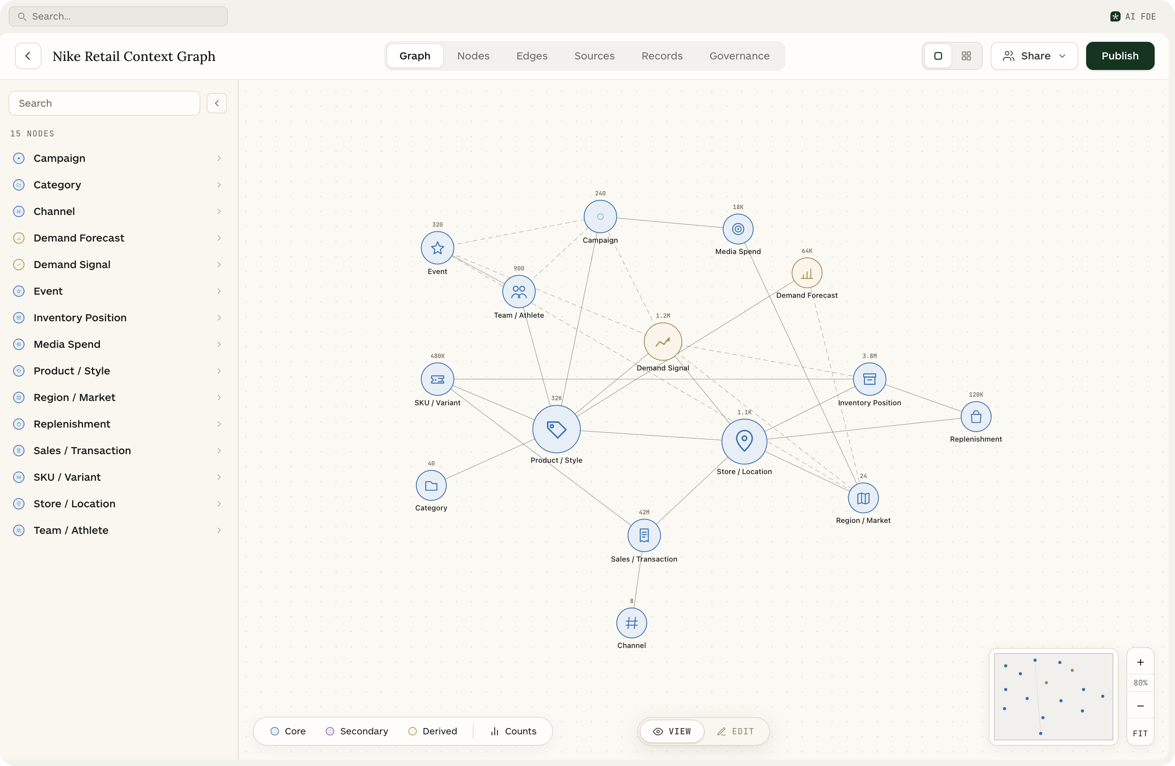


02 · THE CONCEPT
One graph over the systems Nike already runs
Nodes — the retail objects
15 objects: Product, Store, Demand Signal, Campaign, Media Spend, Inventory, Replenishment, Event, Team…
Edges — the relationships
27 connections that make attribution walkable: SOLD_AT · DRIVEN_BY · INFLUENCED_BY · CONSTRAINED_BY
Sources — the systems of record
SAP, Commerce Cloud, Retail POS, Snowflake, o9, Manhattan WMS, Adobe, Paid Media, Marketing Cloud, Market Signals
Anchored on Product × Store — the level where every “why is this selling here” question actually lands.
The live Nike Retail Context Graph in the prototype
Notes:
Not a new platform — a graph layered over their existing stack. Walk the three layers: objects, relationships, and the ten systems feeding them.

Slide 4



03 · WHY A GRAPH
Attribution is traversal — not another dashboard
Connected, not joined
Multi-modal retrieval
Answers you can audit
Demand, media and supply meet at Product × Store × Time. Answering “why” becomes a graph walk — not a quarter-long BI project.
Agents pick the right tool per hop: Cypher on the graph, SQL on Snowflake, semantic search across knowledge — in one chain of thought.
Every claim carries a citation to the exact record it read — a demand signal, a spend line, an inventory position. Trust is built in.
One hop at a time: Product → SOLD_AT → Store → HAS_DEMAND → Demand Signal → DRIVEN_BY → Event · INFLUENCED_BY → Campaign · CONSTRAINED_BY → Inventory
Notes:
Why graph vs dashboard: dashboards answer known questions; the graph answers the next question. Emphasize multi-modal — Cypher first, then SQL and semantic where they fit.

Slide 5
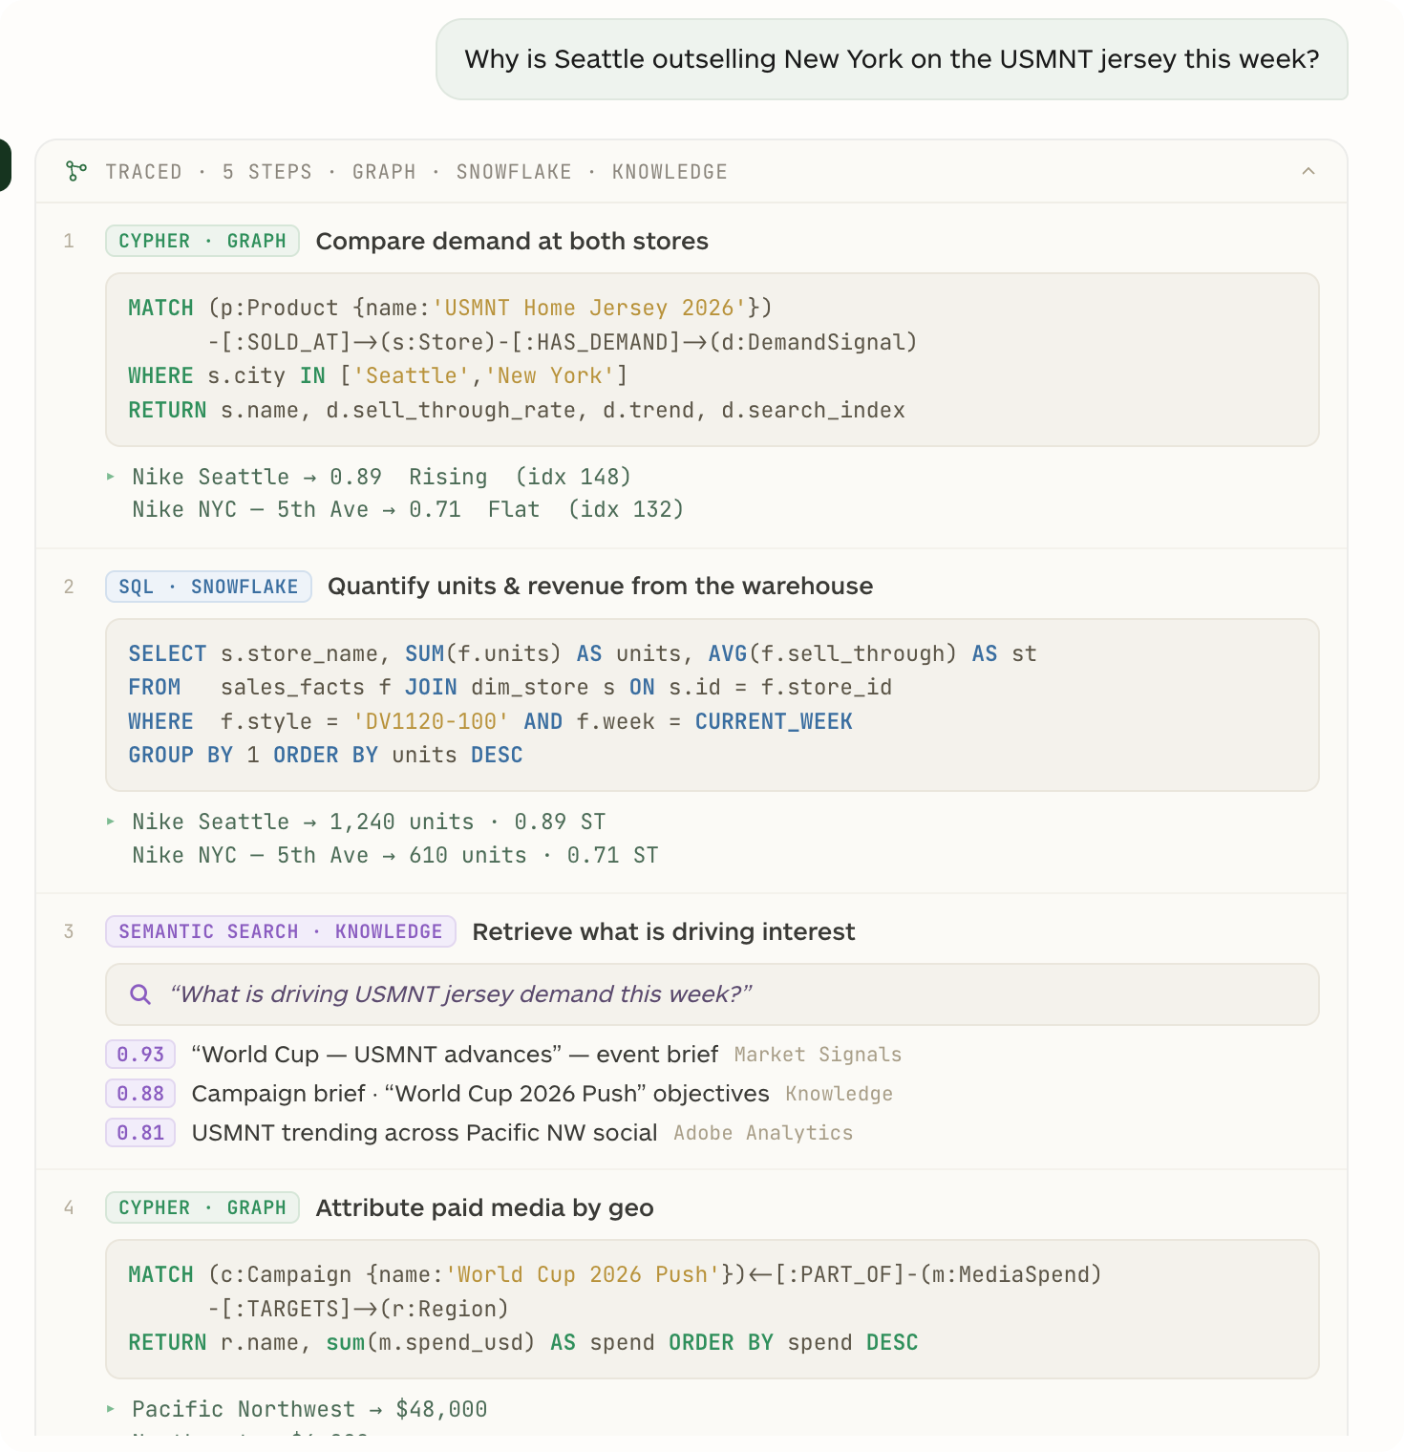
04 · DEEP DIVE — THE TRACE
Watch the question run
“Why is Seattle outselling New York on the USMNT jersey this week?”
1
CYPHER · GRAPH
Compare demand at both doors
▸ Seattle 0.89 Rising · NYC 0.71 Flat
2
SQL · SNOWFLAKE
Quantify units in the warehouse
▸ 1,240 vs 610 units this week
3
SEMANTIC · KNOWLEDGE
Retrieve what’s driving interest
▸ “World Cup — USMNT advances” (0.93)
4
CYPHER · GRAPH
Attribute paid media by geo
▸ $48K Pacific NW vs $6K Northeast
5
CYPHER · GRAPH
Check supply & inbound cover
▸ NYC 1.2 wks · ETA 3d — Seattle 5.4 wks
Notes:
The agent’s chain of thought, live in the prototype: Cypher first on the graph, then SQL on Snowflake for hard numbers, then semantic search over knowledge for the driver. Each step shows its query and its result.

Slide 6
05 · DEEP DIVE — THE ANSWER
Seattle’s lead is real demand amplified by media. New York isn’t lower demand — it’s supply-constrained.
~60%
~40%
The tell: purchase intent is intact
NY search index 132 vs Seattle’s 148 — within striking distance. New York wants the jersey; it can’t buy it, and isn’t being reminded to. A fulfillment gap misread as a demand gap.
of the gap is media allocation
is a New York stockout
$48K of paid spend in the Pacific NW vs $6K in the Northeast — an 8× skew.
1.2 weeks of supply at Nike NYC, replenishment SH-5540 still 3 days out.
Recommended actions
1 Expedite SH-5540 into Nike NYC to break the stockout 2 Rebalance ~$15K of Pacific NW spend to the Northeast while the event window is open 3 Hold Seattle — converting cleanly, near diminishing returns
GROUNDED IN: [1] SIG-587794 SIGNAL · [2] EV-771 EVENT · [3] AD-9912 SPEND · [4] IP-7781 INVENTORY · [5] SH-5540 REPLENISHMENT
Notes:
The answer is decomposed and cited. 60/40 split between media skew and stockout; search-index proof that NY intent is intact. Every number resolves to a graph record — that’s the difference from a BI guess.

Slide 7
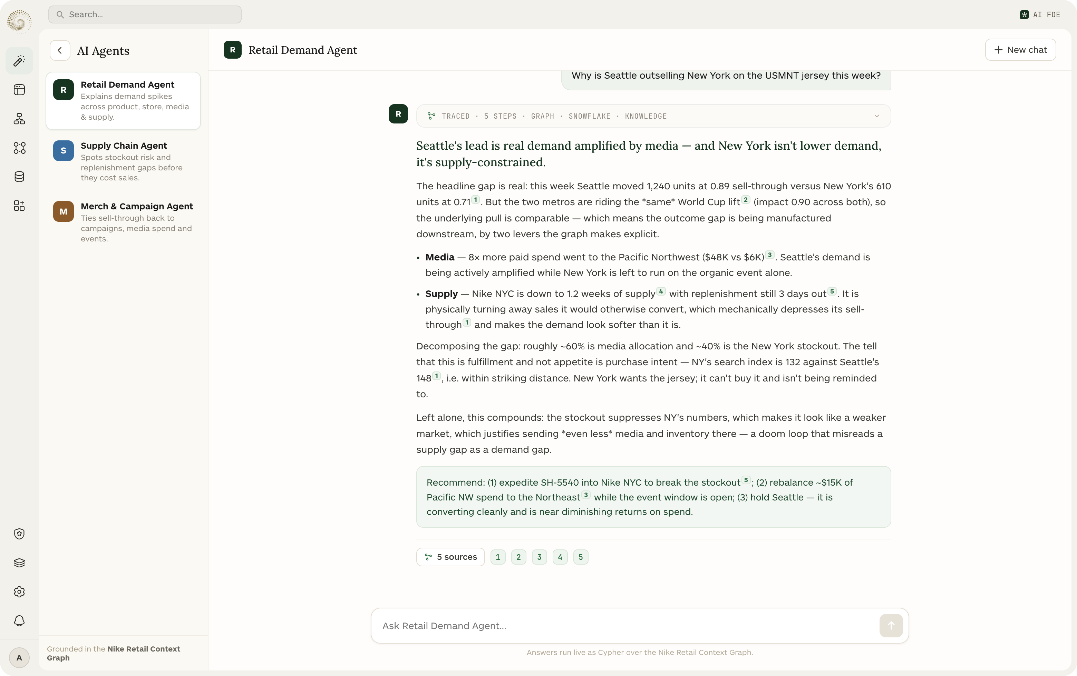
06 · LIVE PROTOTYPE
Let’s ask it live
1
The graph
15 nodes · 27 edges · 10 sources, on canvas
2
Source pipelines
How SAP, POS, media & planning map in
3
Records
Every node backed by inspectable records
4
Agents
Run the Seattle question end-to-end
The Retail Demand Agent answering with citations, live
Notes:
Hand off to the live prototype here. Demo order: graph canvas → a source pipeline (Jira-style mapping) → records → the agent chat with the Seattle question. Close on: this is their business, connected.

